Slide 1


Employee’s Performance for HR Analytics
DONE BY: Isa Abdulla

Slide 2

Introduction
Employee performance is key to a company’s success. However, many companies struggle to understand what helps employees perform well. Using HR analytics, businesses can make better decisions based on data instead of guesses.

Slide 3
Problem Statement
Employee performance is one of the most important factors in an organization’s success. However, many companies struggle to identify which factors truly drive high performance, engagement, and retention. By applying HR analytics, organizations can move away from intuition-based decisions and toward evidence-based workforce strategies.

Slide 4
My Role
Clean and prepare employee performance data.
Perform exploratory data analysis (EDA).
Identify patterns, trends, and correlations.
Build performance segmentation and predictive insights.
Translate findings into recommendations.

Slide 5
Dataset Overview
Features:
Content 17,417 employees.
Demographics: Age, gender, education, department, region.
Work attributes: Recruitment channel, length of service, number of trainings.
Performance indicators: KPI , average training score, previous year rating, awards won.

Slide 6
EDA INSIGHTS
Age Distribution: Most employees are between 28–35 years, indicating a young workforce.
Length of Service: Majority have 3–7 years of tenure, suggesting early/mid-career employees dominate.
Previous Year Rating: About 40% have missing ratings, possibly due to being new hires.
Training Scores: Employees with an average training score above 75 are more likely to meet KPIs.
Awards: Very few employees (~2%) received awards, but those who did had a strong correlation with KPI success.
Recruitment Channel: The “other” channel accounts for most hires, while referrals are the least used.

Slide 7
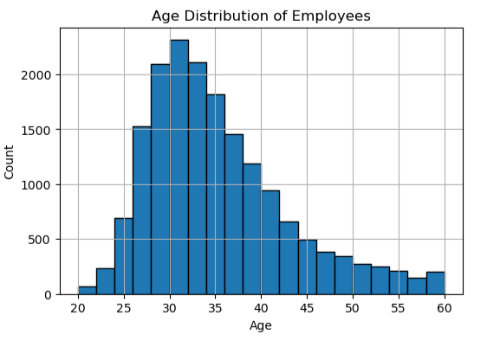
Most employees are between 28–35 years, indicating a young workforce.
Age 28–35 % 47.89

Slide 8
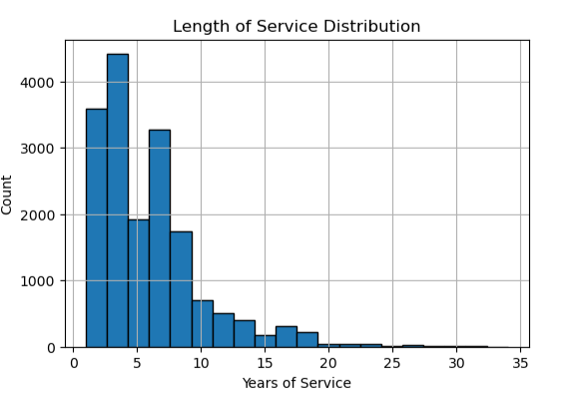
Majority have 3–7 years of tenure, early/mid-career employees dominate.
Tenure 3–7 years % 55.09

Slide 9
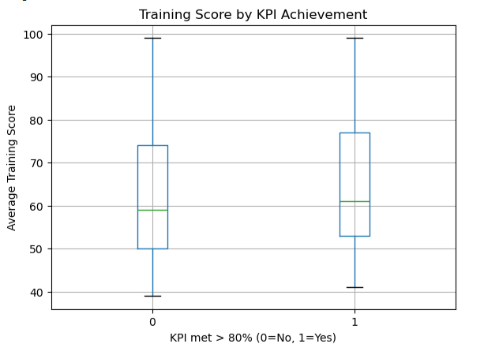
Employees with an average training score above 75 are more likely to meet KPIs.
compares training scores for employees who did or did not meet their KPIs. Those who met KPIs generally have higher training scores.

Slide 10
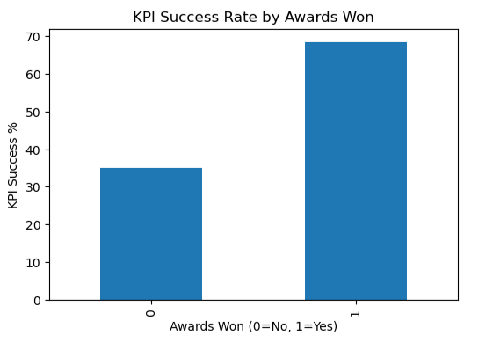
Very few employees (~2%) received awards, but those who did had a strong correlation with KPI success.
compares KPI achievement for employees with and without awards. We can clearly see that those who received awards had a much higher KPI success rate.

Slide 11
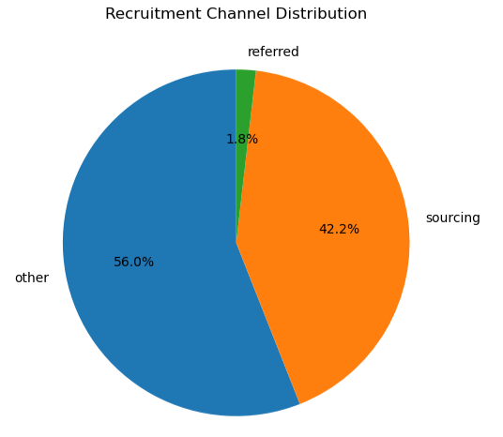
The “other” channel accounts for most hires, while referrals are the least used.
Recruitment channel: other 55.99%
Recruitment channel: sourcing 42.19%
Recruitment channel: referred 1.82%

Slide 12
Goals
Identify the key factors that influence employee performance.
Provide actionable recommendations for training, recruitment, and retention.
Segment employees to highlight high potential talent and those needing support.
Deliver a data-driven framework that HR leaders can use to boost engagement and productivity.

Slide 13
objective
identify the key factors that influence employee performance.
examine the relationship between employee training and KPI achievement.
analyze the impact of demographic factors (such as age, education, and tenure) on employee performance.
compare performance levels across different departments within the organization.
assess how recruitment channels are related to employee performance.
evaluate the overall distribution of KPI achievement among employees.

Slide 14
Questions
What are the key factors that influence employee performance?
How does training relate to KPI achievement?
Do demographics such as age, education, and tenure impact performance?
Which departments show higher performance levels?
How do recruitment channels relate to performance?
What does the overall KPI achievement distribution look like?

Slide 15
Audience
HR leaders
Managers
Executives
Business leaders
Organizational decision-makers

Slide 16

THANK YOU

